Slide 1
Gene expression analysis
PSL374
Brian Cox, PhD
Instructor

Slide 2
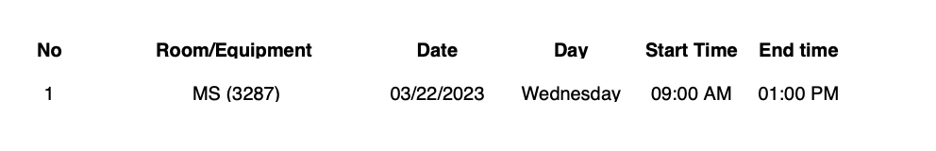
Classroom change for Wednesday

Slide 3
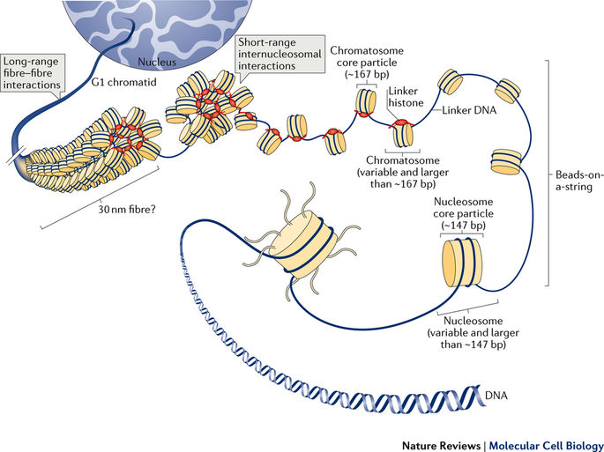
Genome

Slide 4
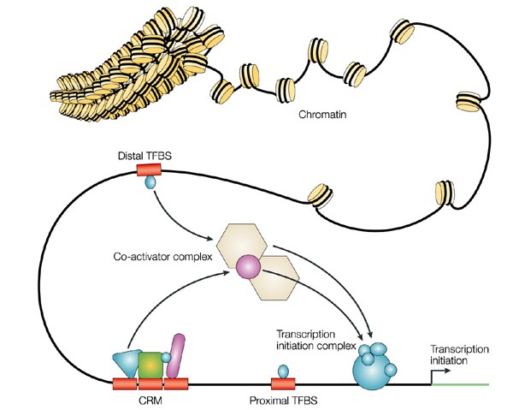
Gene expression is regulated
Different regions of the genome
Co-ordinate expression
Activators, repressors
Enhancers, promoter
Wyeth W. Wasserman & Albin Sandelin
Nature Reviews Genetics 5, 276-287 (2004)

Slide 5
Transcriptome, the transcribed genome
In the case of gene expression we are looking only at the transcribed regions (exons)
Total of all expressed RNA is the transcriptome
Transcribed but, spliced out are the introns
Introns can contain other used transcription products like small RNAs (microRNAs and piwi RNA)
promoter
intron
TSS – transcriptional start site
UTR – untranslated region, does not code for protein, but important for regulation of the RNA
TSS
DNA
5’ UTR
exon
3’ UTR

Slide 6
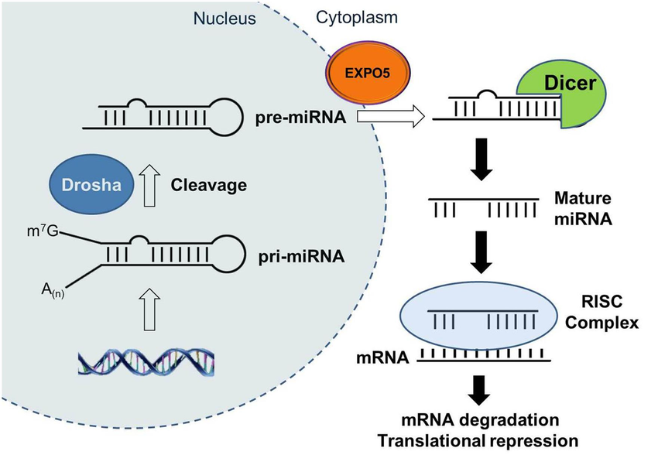
Transcriptome is more than protein coding
RNA can be one of two kinds
Protein coding
Loads on to the ribosome for translation
Non-coding
Long non-coding RNA, 1000s of bases long
XIST (X inactivation in females), rRNA (functional parts of the ribosome)
Small non-coding RNAs, 100s of bases when transcribed but processed by nucleases into 19-14 base final product
microRNAs, Piwi, tRNA
Pseudogenes, variable 100s to 1000s of bases long
Lost reading frame, will not make a protein
Spliced and unspliced mRNAs

Slide 7
Gene expression analysis
By sequencing the RNA what kinds of analyses can be performed?

Slide 8
Experimental design
A quality experiment involves 3 main things:
The Question
2) The Sample Size
(power)
3) The Controls
Questions on the unique characteristics and functions of a population, tissues, cells etc
Do you have enough samples to detect a difference? Considers noise of samples and technique.
How do you know the experiment worked/failed?
That the effect is biologically relevant?

Slide 9
Power analysis/ Sample size
Two issues, detection and quantification
Detection
Is the gene or transcript present/absent?
Quantification
Is there more or less between groups
Power to detect differences
This is proportional to the variance (mu)
High variance needs more samples to be certain of a difference
Low variance needs fewer samples
Often we start with a few sample to determine how many samples are needed

Slide 10
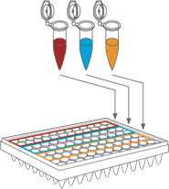
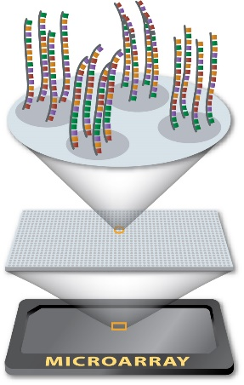
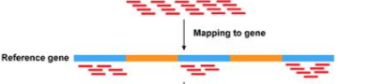
Comparison of techniques
RNA-Sequencing
qPCR
Microarray
Targeted method
known
Genome wide
Known genes
Genome wide
Know and discovery

Slide 11
Sequencing, The next generation
Massively parallel, millions to billions of reads per analysis run
A read is a single stretch of sequence
75-150 bases long
500 million reads for $2500
200,000 reads/dollar
Typical read by Sanger method $5 each
But covers 500-1000 bases

Slide 12
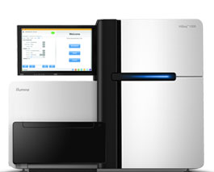
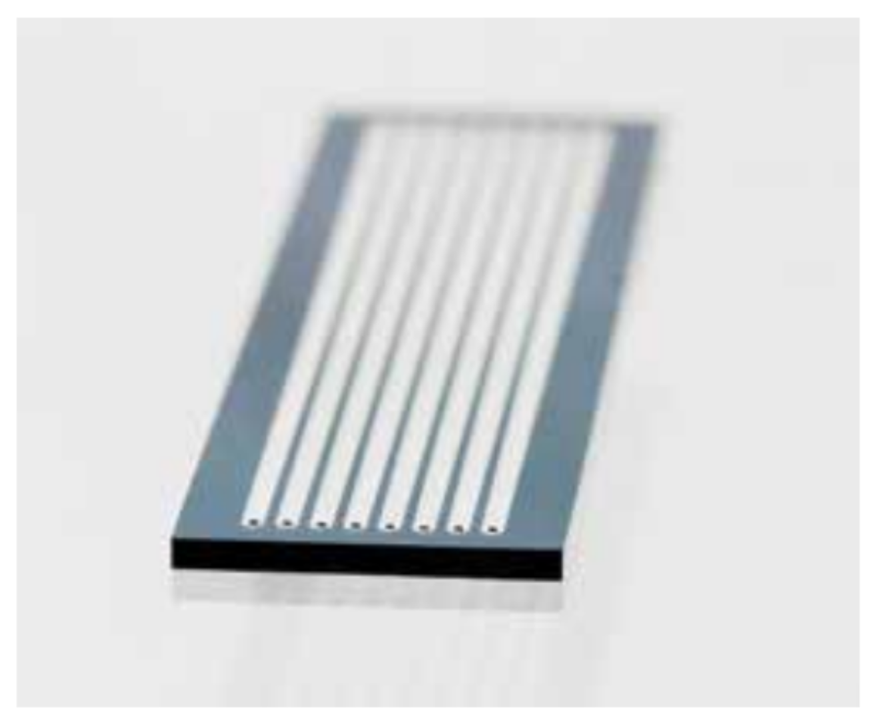
Sequencing, Illumina
On board amplification
In a flow cell
Uses PCR
Florescence based sequencing
Imaging to detect sequence

Slide 13
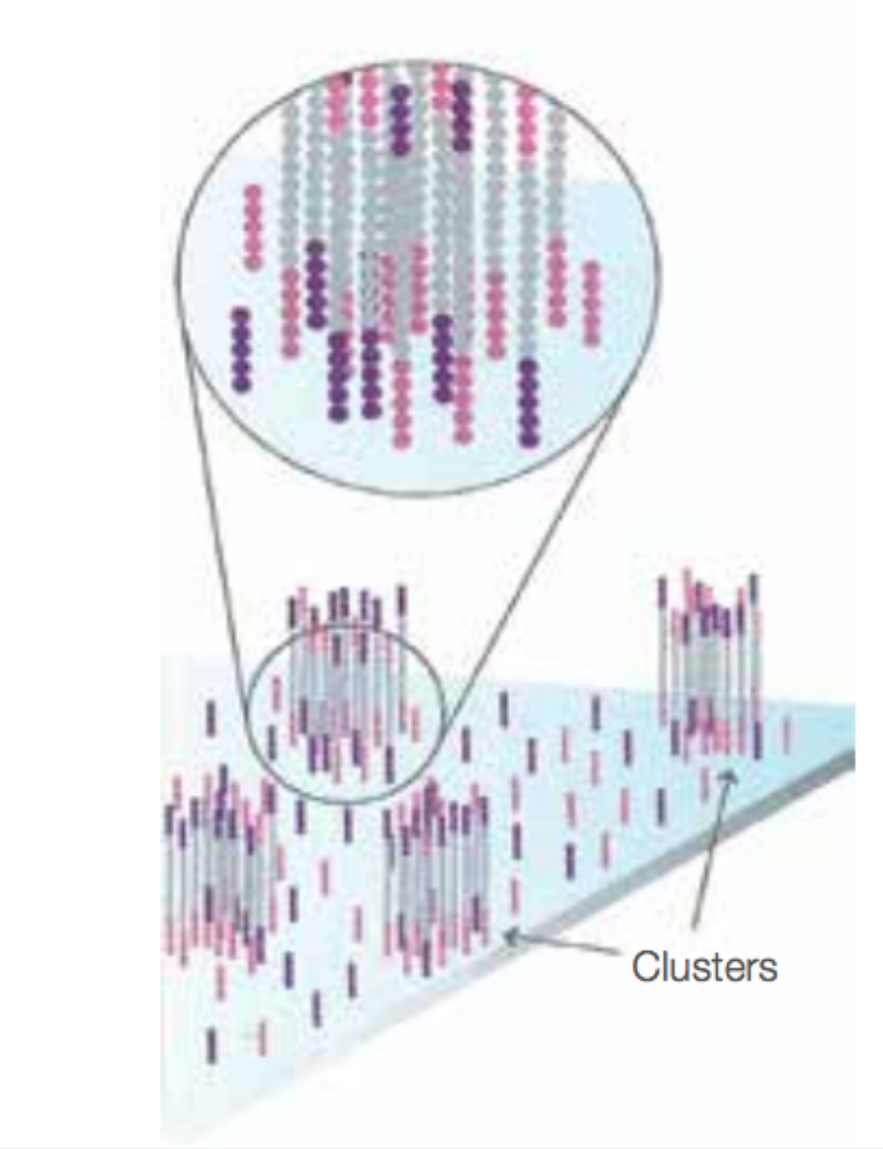
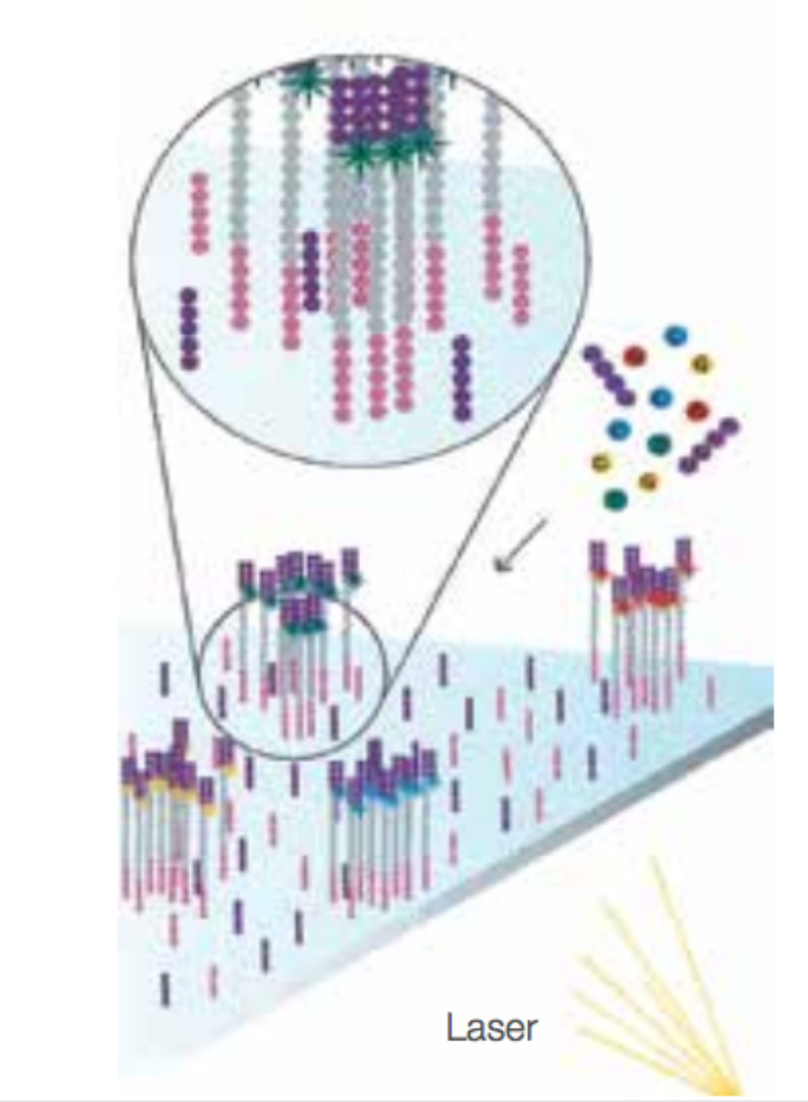
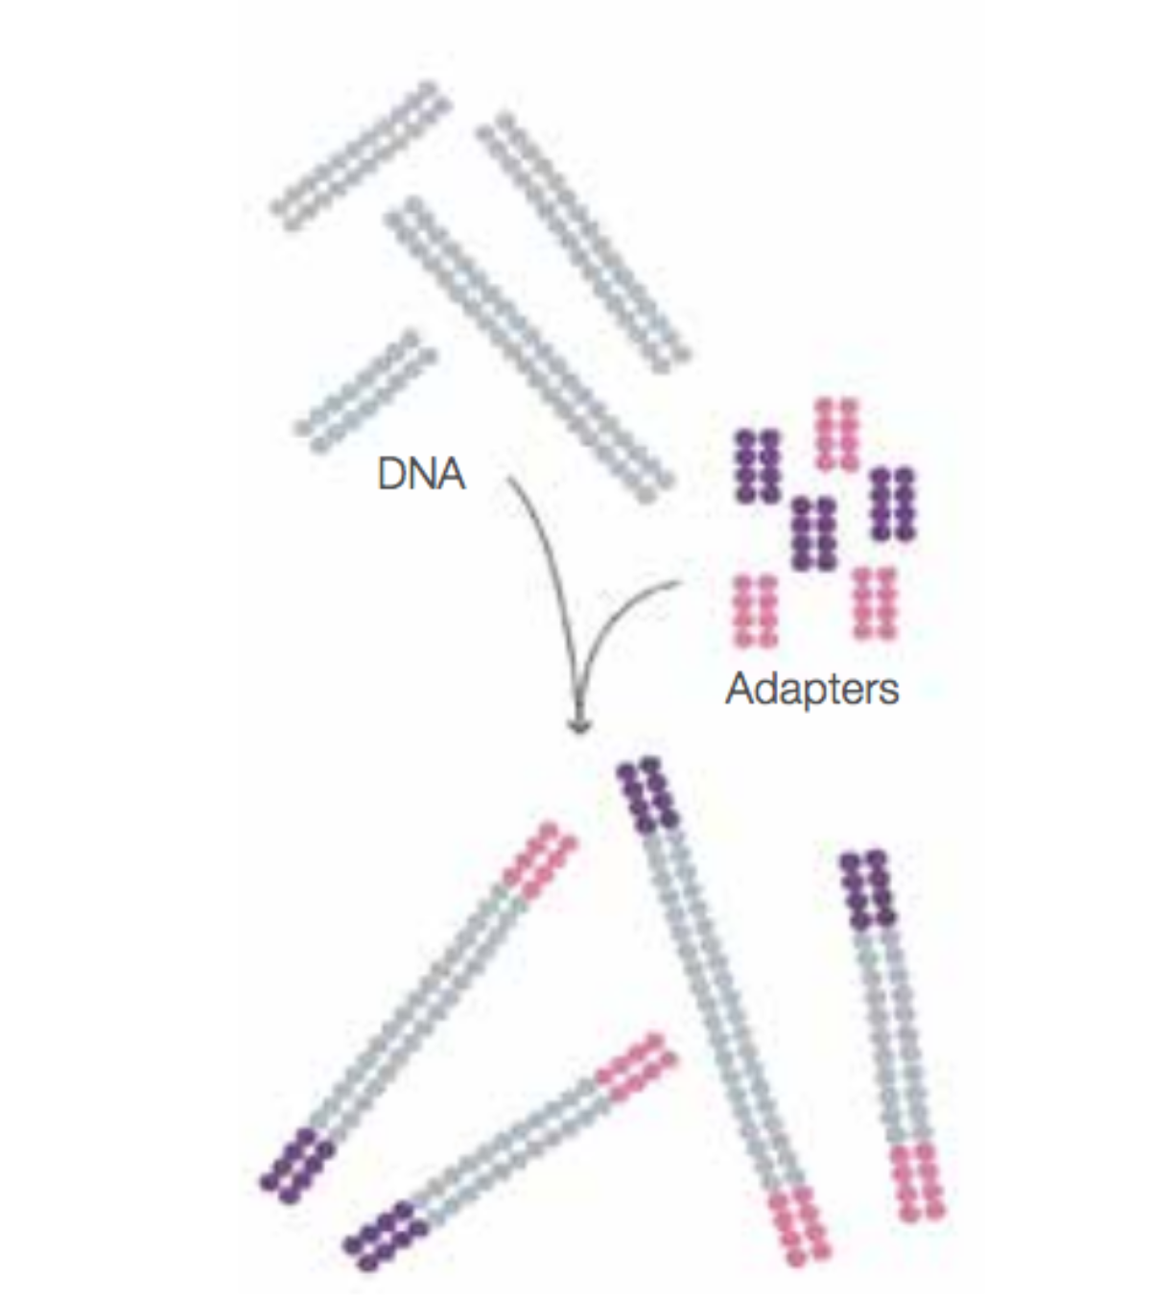
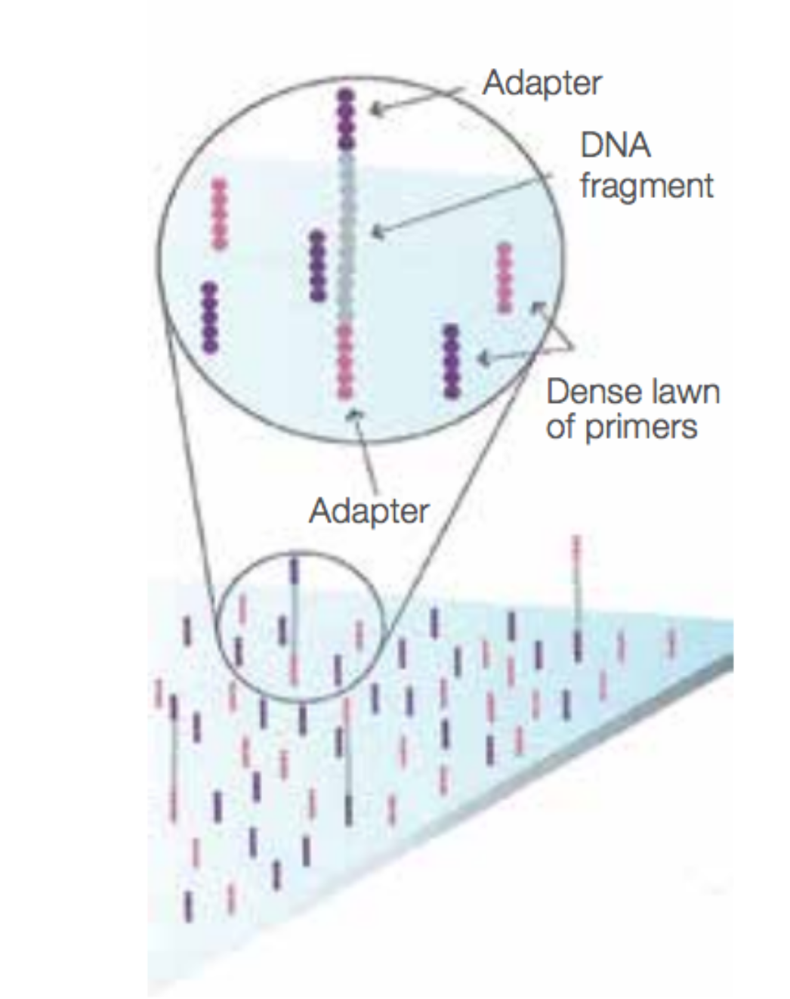
Sequencing, Illumina
Sequences are randomly spaced on a flat surface
Use PCR to build the sequence colony

Slide 14
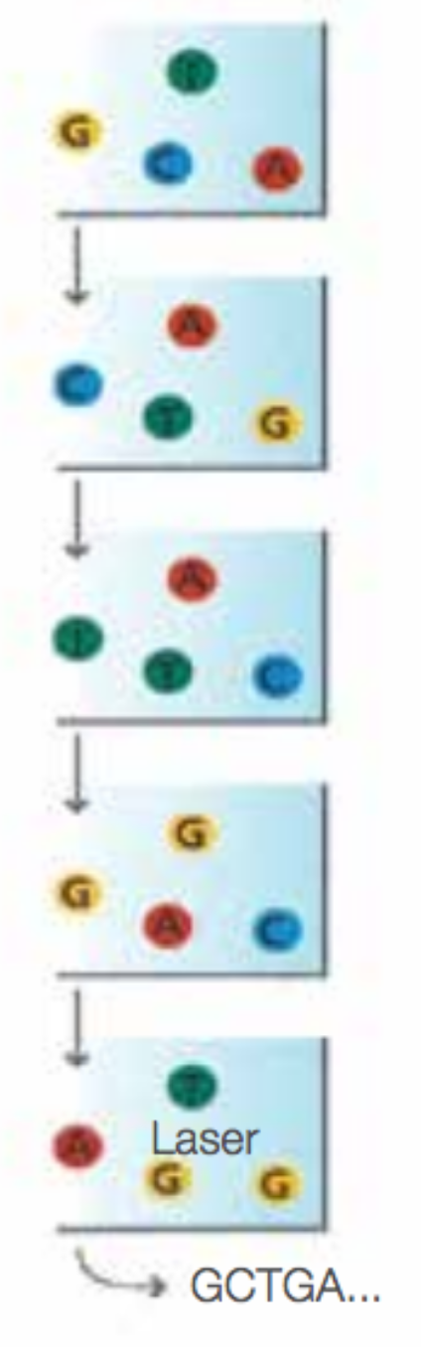
Sequencing cycle
Labeled nucleotides are added
Polymerase incorporates
Each colony should have one new nucleotide added
The flow cell is imaged
The dye is cleaved and washed
Repeat the cycle
The order of the images is the sequence
Round 1
Round 2
Round 3
Round 4
Round 5

Slide 15
FASTQ
Raw sequence data with quality scores

Slide 16
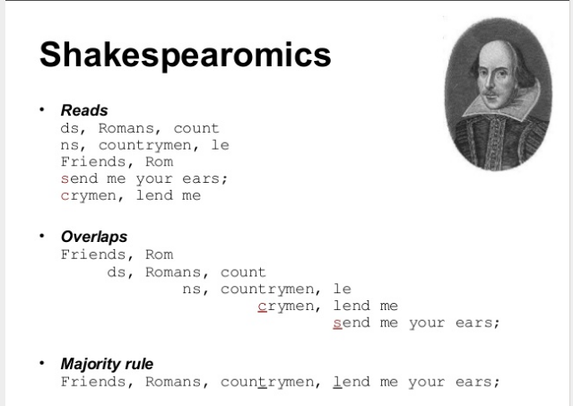
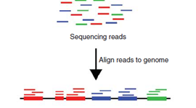
Alignment
FASTQ Format
Many Mapping tools have been developed to assist with mapping of transcriptome data.
These trade speed and accuracy.
BOWTIE2, BWA, TOPHAT, SHRIMP, STAR,GSNAP, HISAT2, SAILFISH

Slide 17
Count table

Slide 18
Gene expression concepts
Normalize or Standardize
Data collected under different conditions
Range (min and max) and means may be different
Must normalize to make equivalent
Normalcy
Is the distribution normal
Transform, typical is log₂
Differential expression
Many methods, linear models, t-test
Must correct or adjust the test statistic, FDR, Bonferoni, etc.
Too many tests, inflates the false positives

Slide 19
Gene expression concepts
Normalize
Data collected under different conditions
Range (min and max) and means may be different
Must normalize to make equivalent
Normalcy
Is the distribution normal
Transform, typical is log₂
Differential expression
Many methods, linear models, t-test
Must correct or adjust the test statistic, FDR, Bonferoni, etc.
Too many tests, inflates the false positives

Slide 20
Quantification
RNA-sequencing
Counting, integer
heteroskedasticity, variance is dependent on the mean

Slide 21
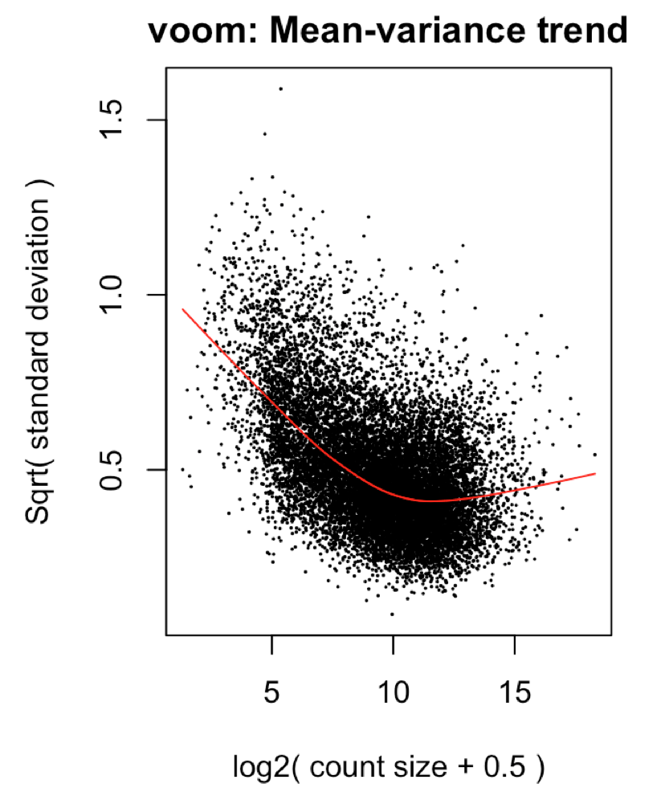
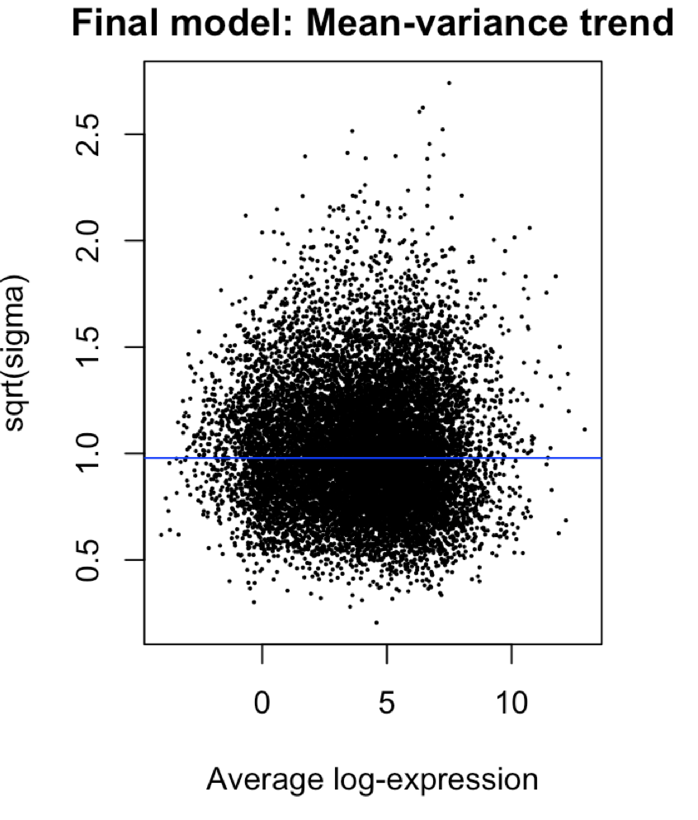
Quantification
RNA-sequencing
Counting, integer
heteroskedasticity, variance is dependent on the mean

Slide 22
Batch effect
After normalization can still have an issue
Batch
A grouping of samples that were analyzed at the same time
The batch effect
Presence of multiple batches
Can affect the measurement of some genes in a batch
Each batch can have its own
Possible sources are
Different day, Lot of reagents, Person performing experiment, Different instrument (same model)

Slide 23
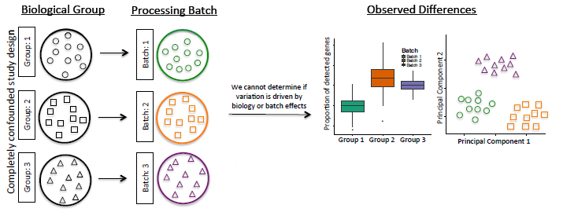
Experimental design
Experimental design can be used to prevent or compensate for the batch effect
Each batch should have all phenotypes represented
If each batch is a unique sample type, controls, treatment) batch effect can not be fixed
Both batch and treatment are the same, Co-variant
Batch Effect:
Technical variation in the processing sample (Batch)
Requires Randomization

Slide 24
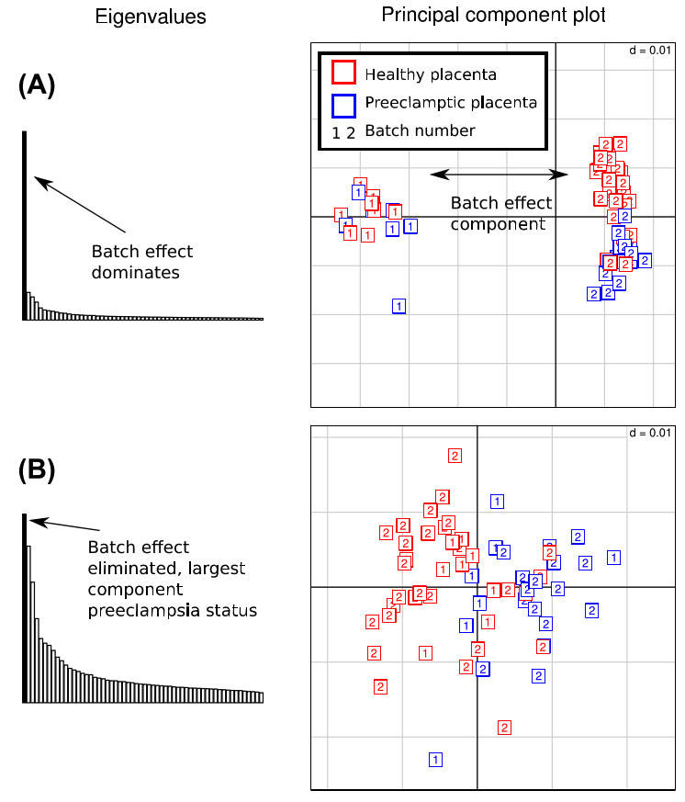
A batch effect
The histogram is the PC % variance
The scatter plot are the samples
Coloured by phenotype
Numbered by batch
After correction the batches intermingle and the dominate component is the phenotype
Can be removed as each batch has both phenotypes represented

Slide 25
General object structure
RNA-seq uses the DGEList (differential gene expression list)
Used by edgeR, limma
There are other object types in other packages
Consists of three main elements/tables
Expression data matrix, columns of samples rows of genes
Phenotype data frame, columns of attributes rows of samples
Feature data frame, columns of attributes, rows of genes

Slide 26
DGEList object
samples
The tables are held dynamically
Processing the samples table automatically processes the gene expression table
Similar for the feature table and expression table
descriptions
descriptions
samples
genes
genes

Slide 27
DGEList – Differential Gene Expression List
Stores similar information
Uses a list style object
names() accesses the positions
Samples is equivalent to phenotype table
Counts is same as assay data
Genes is same as feature data
> names(x)
[1] "samples" "counts" "genes"

Slide 28
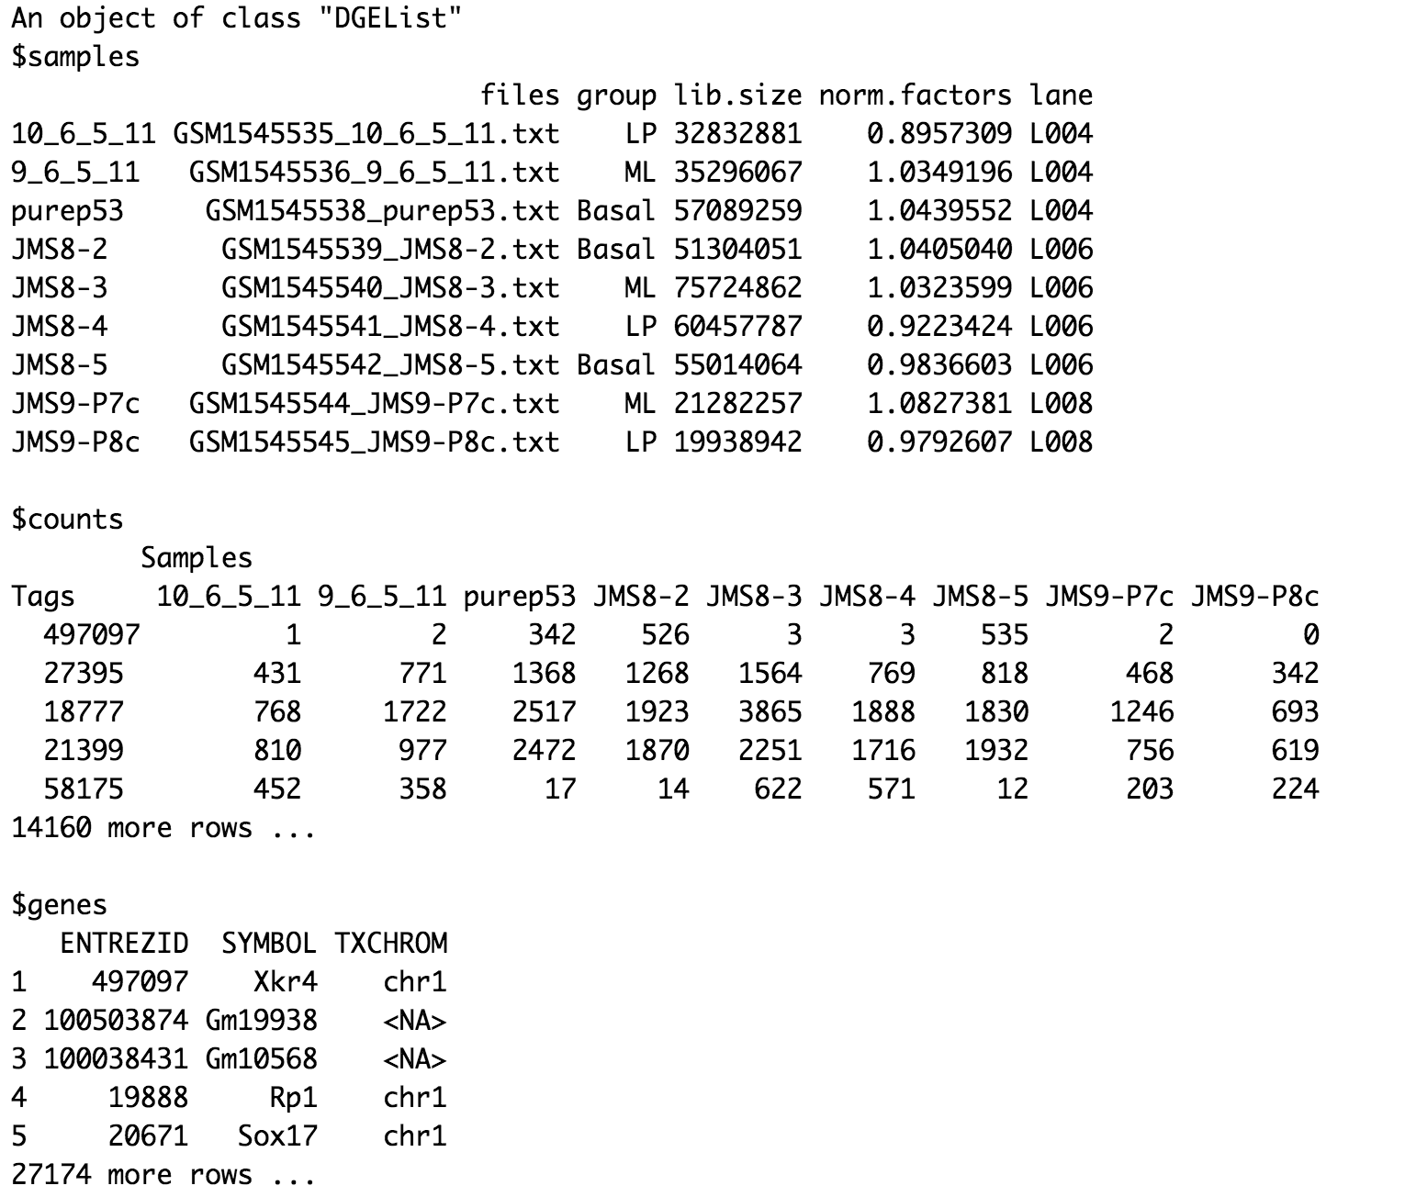
DGEList
Multiple list slots
The samples slot is updated by different functions
lib.size is calculated automatically
Norm.factors are calculated by a funciton

Slide 29
Limma

Slide 30
The voom object
Voom is similar to the DGEList object
An EList (Expression List)
Genes is the genes table,
Targets is the samples table
E is the expression matrix
Weights are to transform the data
Design is the the experiment design, samples batches etc.
> names(v)
[1] "genes" "targets" "E”
[4] "weights" "design"

Slide 31
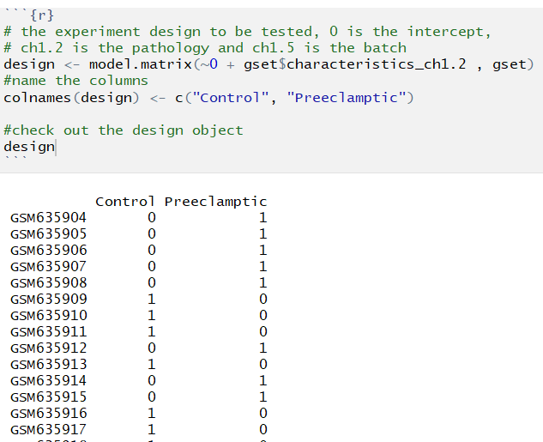
Design matrix
Limma uses linear models
y=mx+b
Sample annotation used
Categorical or continuous variables
Solving for
Differentiation expression
E.g., Healthy vs Sick
Adjusting (for a technical or confounding variable, batch, weight, age etc)

Slide 32
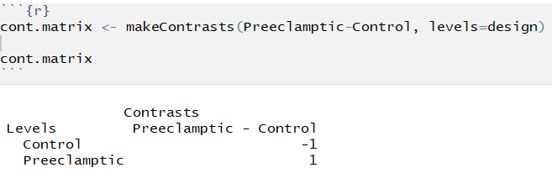
Contrast matrix
The question you are asking
Data is log transformed
Log(a/b)
Log(a) – Log(b)
All values in the design matrix are modelled
If not part of the contrast they are used as a adjustments/corrections
Order affects direction of change
What is up or down?

Slide 33
Differential expression
Once groups/clusters are defined need to understand the difference in expression
Challenge of sequencing data
Counting
Not continuous Gaussian data
Discrete
More related to Poisson or negative binomial
Cannot do an ordinary T-test

Slide 34
Differential expression
Methods
DESeq2, EdgeR, Voom + others
Each uses a different method to model the data and separate technical variation from biological variation
Differences have a statistical test
This should use a correction for multiple testing
Different count levels have different variance, noise in their measurement
Referred to as over-dispersion
Need to find the relationship between mean of the expression and the variance

Slide 35
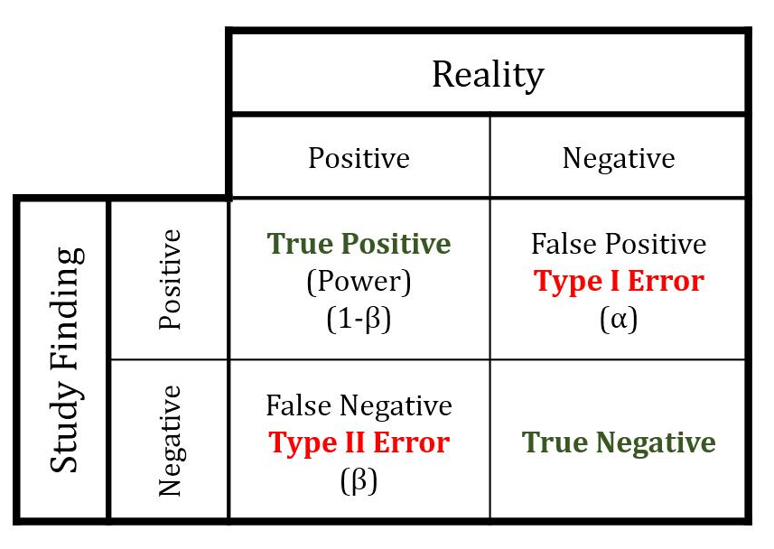
Differential expression
Lots of tests
Need to reconsider errors
Type I, False positives
Type II, False negatives
If you test 1 comparison, a p-value of 0.05 means
A 5% chance that this could be discovered by chance given the data’s distributions.
Note reducing type I error (lower p values) increases type II error
Family wise error rate
Adjust the p-value to account for all of these tests
Family wise error rate
1-(.95)^{n}
N is the number of tests
2 tests is a 0.0975 frequency of false discovery

Slide 36
Differential expression
Log of a fold change
Statistical values, key is the adjusted p-value
Correction for multiple testing
Symbol | logFC | AveExpr | t | P.Value | adj.P.Val | B
DKFZp586I1420 | 0.36 | 6.69 | 8.33 | 1.21E-11 | 5.89E-07 | 16.02
TRIM24 | 0.56 | 8.70 | 7.76 | 1.17E-10 | 2.86E-06 | 13.91
SIAE | 0.45 | 6.30 | 7.60 | 2.23E-10 | 3.12E-06 | 13.31
TUBA1A | -0.55 | 10.25 | -7.56 | 2.60E-10 | 3.12E-06 | 13.17
MPHOSPH1 | 0.30 | 6.28 | 7.51 | 3.21E-10 | 3.12E-06 | 12.97
PPIG | 0.49 | 6.85 | 7.27 | 8.15E-10 | 5.77E-06 | 12.10
HSP90B1 | 0.58 | 11.29 | 7.27 | 8.29E-10 | 5.77E-06 | 12.09
ENG | 0.92 | 10.66 | 7.08 | 1.73E-09 | 9.65E-06 | 11.40
ERCC5 | 0.44 | 8.14 | 7.05 | 1.95E-09 | 9.65E-06 | 11.29
ZNF33B | 0.49 | 7.08 | 7.05 | 1.98E-09 | 9.65E-06 | 11.28

Slide 37
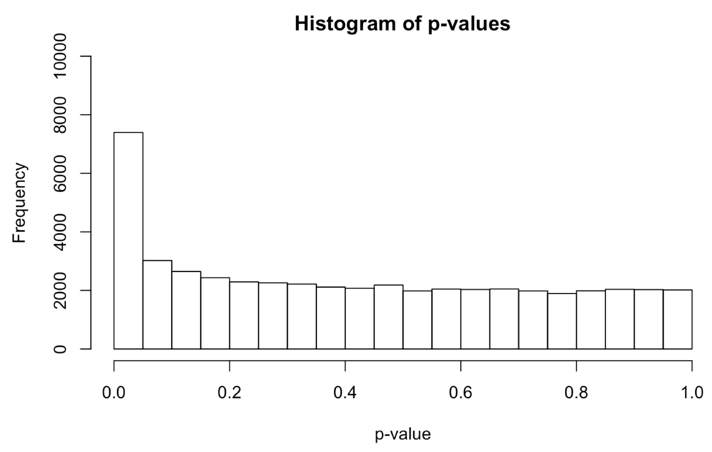
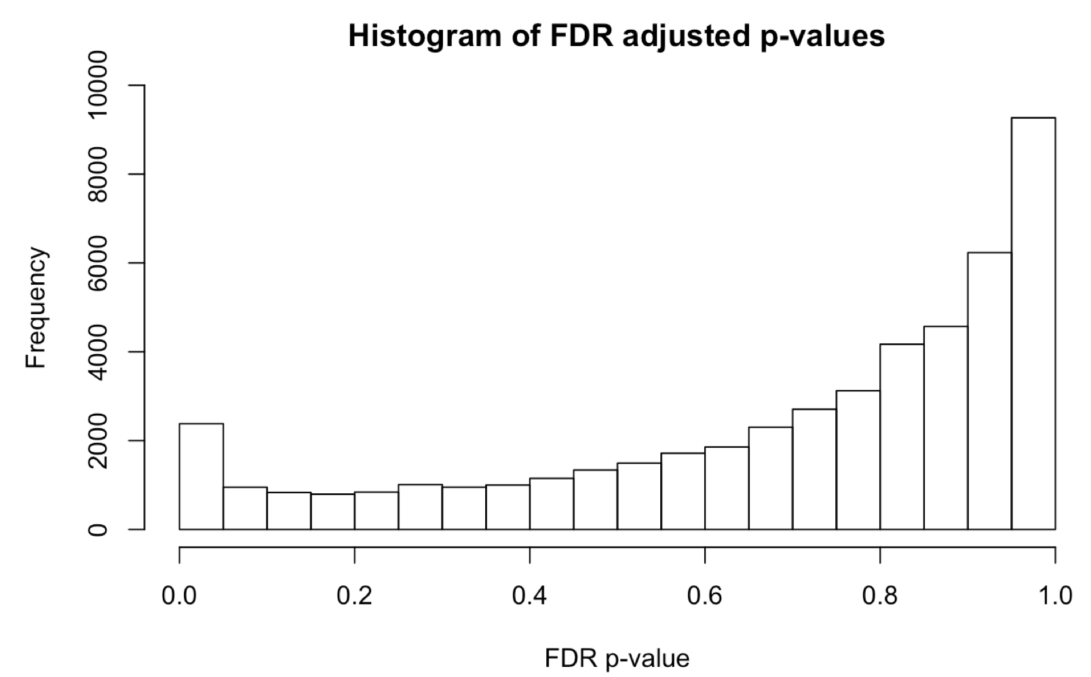
A tail of two p-values
Adjusting can be as simple as dividing
0.05/20,000 = 2.5 x 10⁻⁶, new threshold
But we generally apply other methods like
FDR, Bonferoni, Holm
These will give different results
Considered conservative or liberal

Slide 38
Ontologies
Genes can be grouped in to sets
The Gene Ontology
Molecular Function
Transcription factors, kinases
Biological process
Involved in spleen development, apoptosis
Cellular Component
Nuclear or mitochondrial localized
Genes can be in more than one group
All the differential expressed genes
apoptosis
Transcription factor
kinase

Slide 39
Gene sets and statistical tests
Overrepresentation analysis
Test for enrichment is a select set or group of genes
Possible bias, selection of genes of interest
Arbitrary setting of thresholds, fold change and p-values
Gene set enrichment
Test genes collectively as a set with common annotation
Individually they may not be enriched (not statistically significant), group statistic
Advantage, uses all the data, no selection

Slide 40
Ontology over-representation
Of the genes differentially expressed are there more than expected, based on a random sample/draw?
Governed by the hypergeometic and binomial probabilities
Are there more or fewer genes of one group than could be predicted by random?
All the differential expressed genes
All the genes

Slide 41
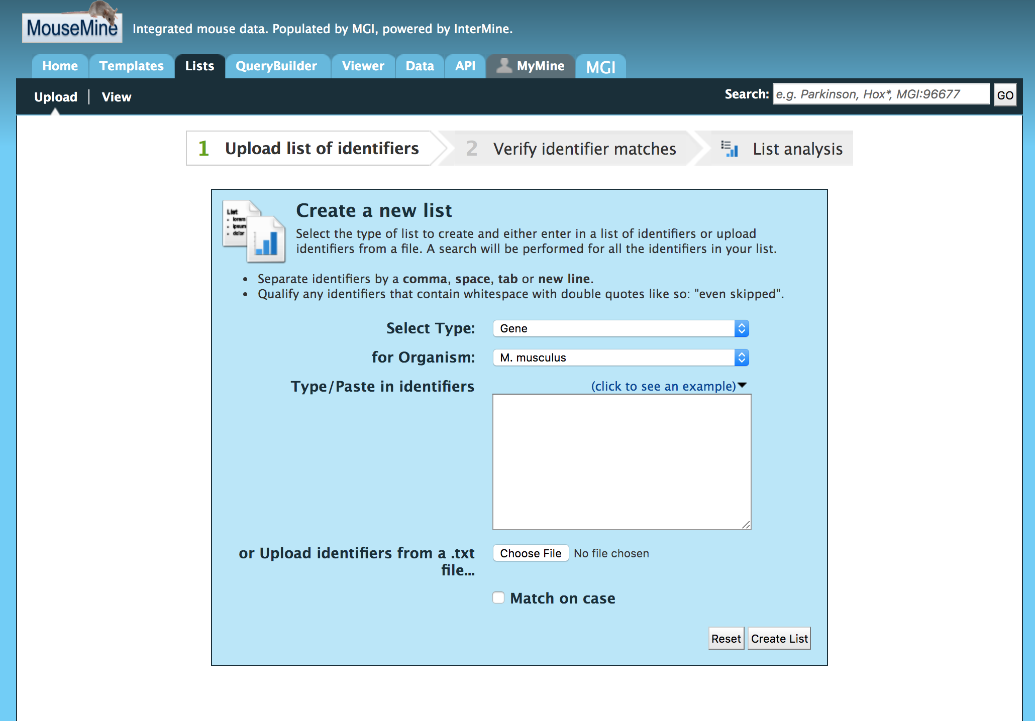
Over representation
Mouse mine is a good resource
Add a list of selected genes
For example increased after treatment with a drug

Slide 42
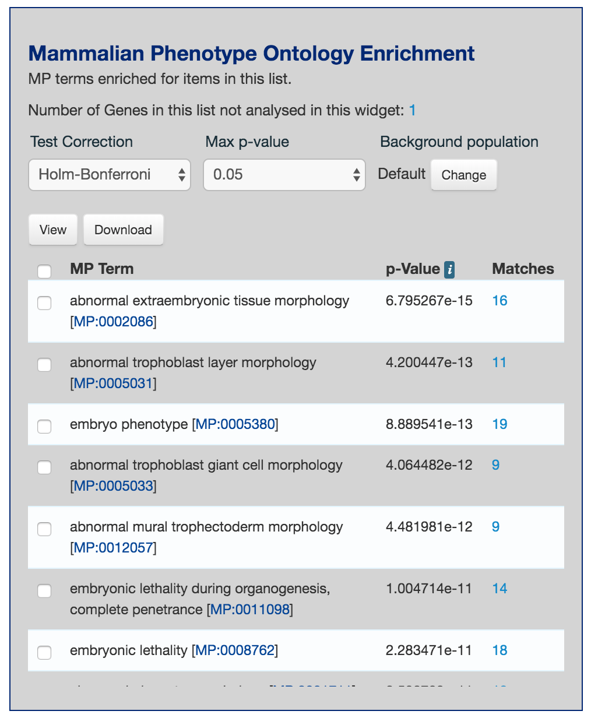
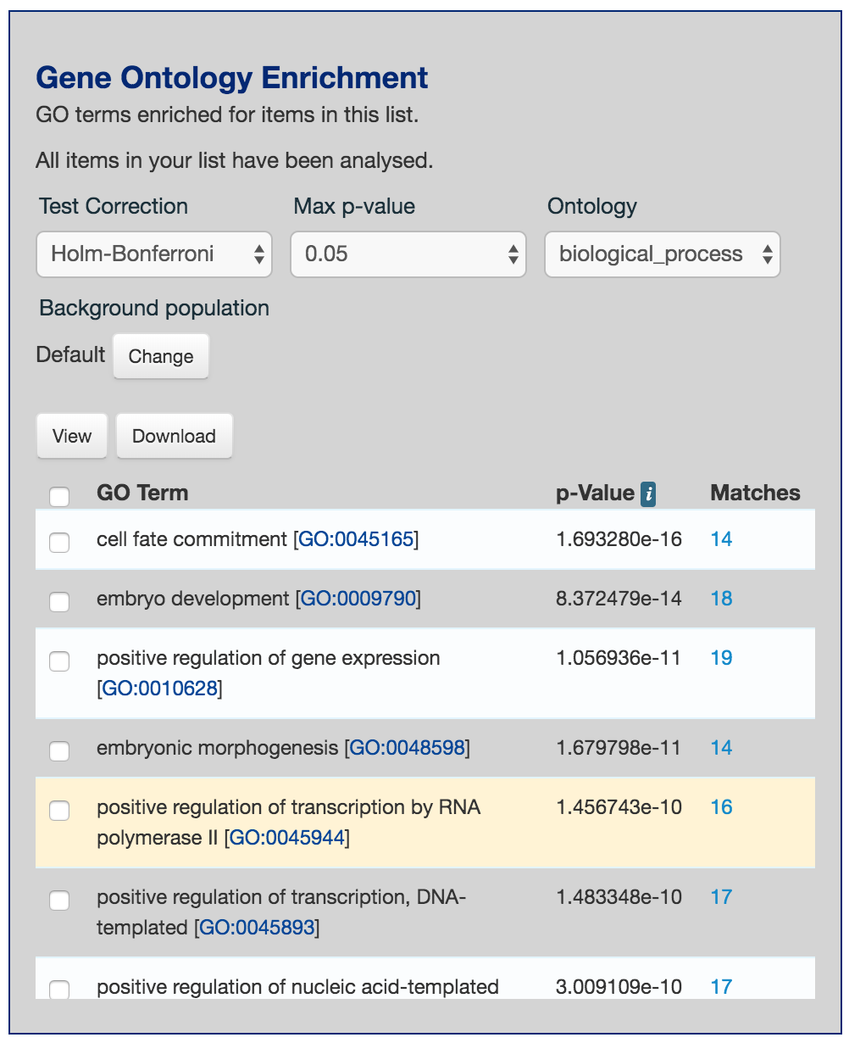
Over representation

Slide 43
Gene set enrichment
Gene | Fold change
ABC | 4.5
DBC | 3.9
NGF | 3.8
….
XCD | -3.3
AAD | -3.5
The camera() function in the limma library
Rank genes in order of expression difference
Test is on the distribution of the genes in the set
Are the genes mostly higher or lower than expected?

Slide 44
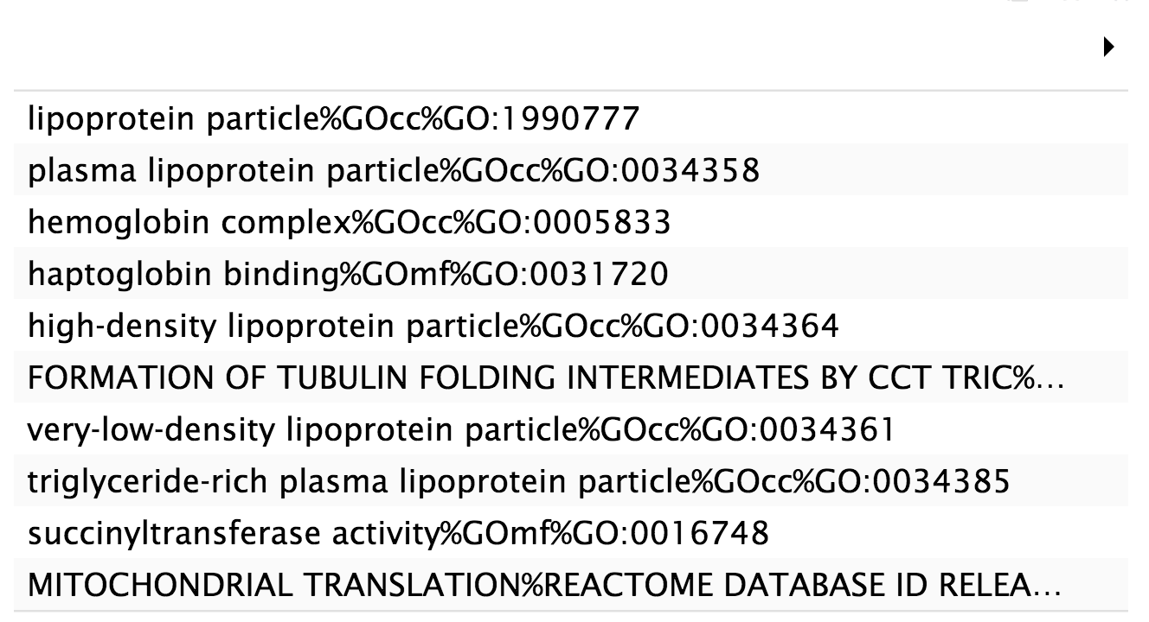
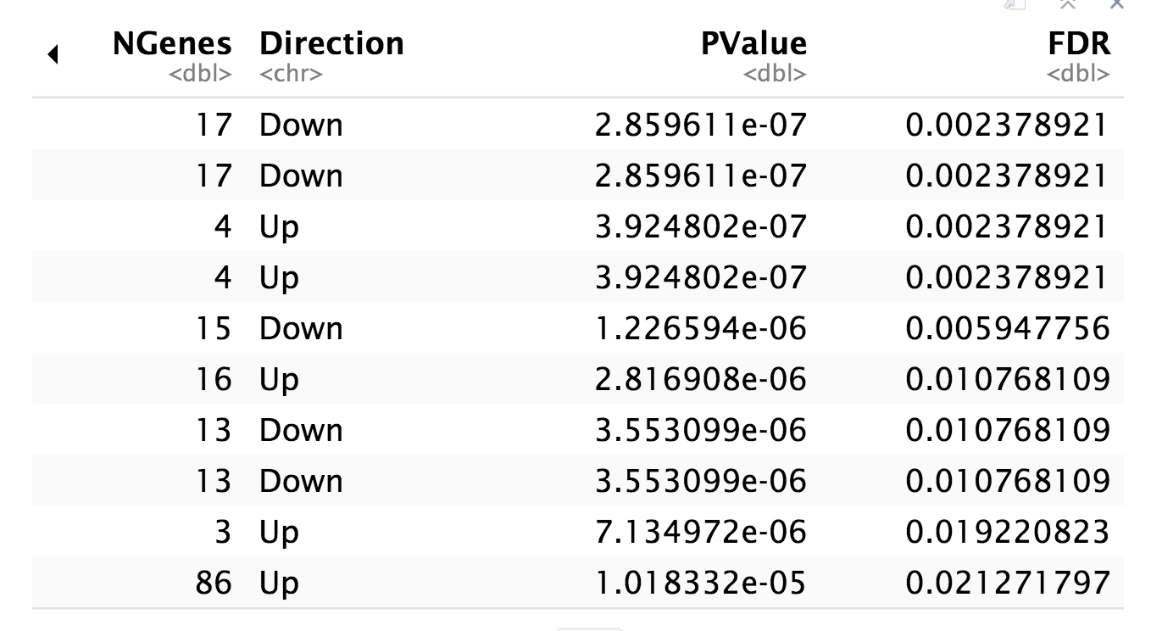
Enrichment Table
Important to read the enriched terms and consider the meaning, 1000’s of members to fewer than 10
How specific is the term?
Is “response to hormone” meaningful?
“regulation of amine transport” binding?

Slide 45
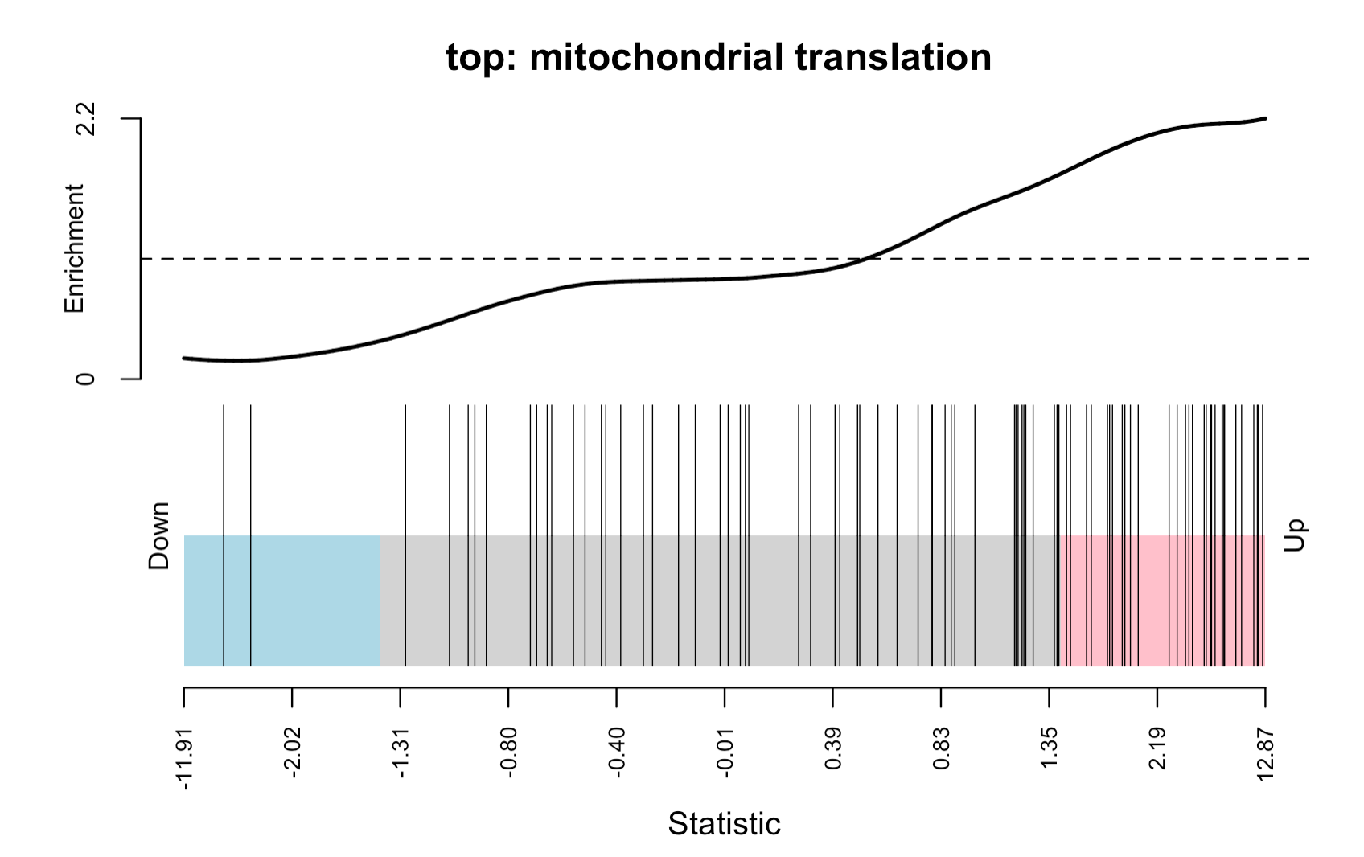
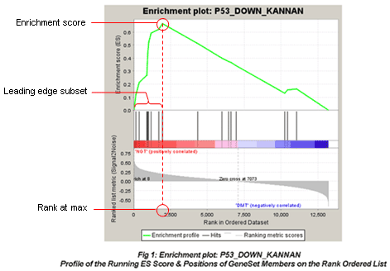
Set enrichment graph
Barcode plot in R
Enrichment plot from GSEA

Slide 46
Summary
Different gene expression techniques geared toward each situation/question/hypothesis
Assay of the RNA in cells/tissues
Avoid or track and correct for batches
Adjust for possible confounding variables
Adjust the p-value
Genome wide techniques are for assessing sets of genes

Slide 47
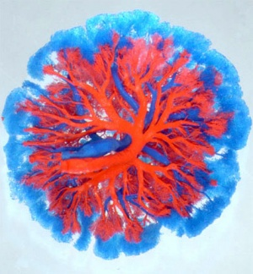
Pregnancy development and adaptations
PSL374
Brian Cox, PhD

Slide 48
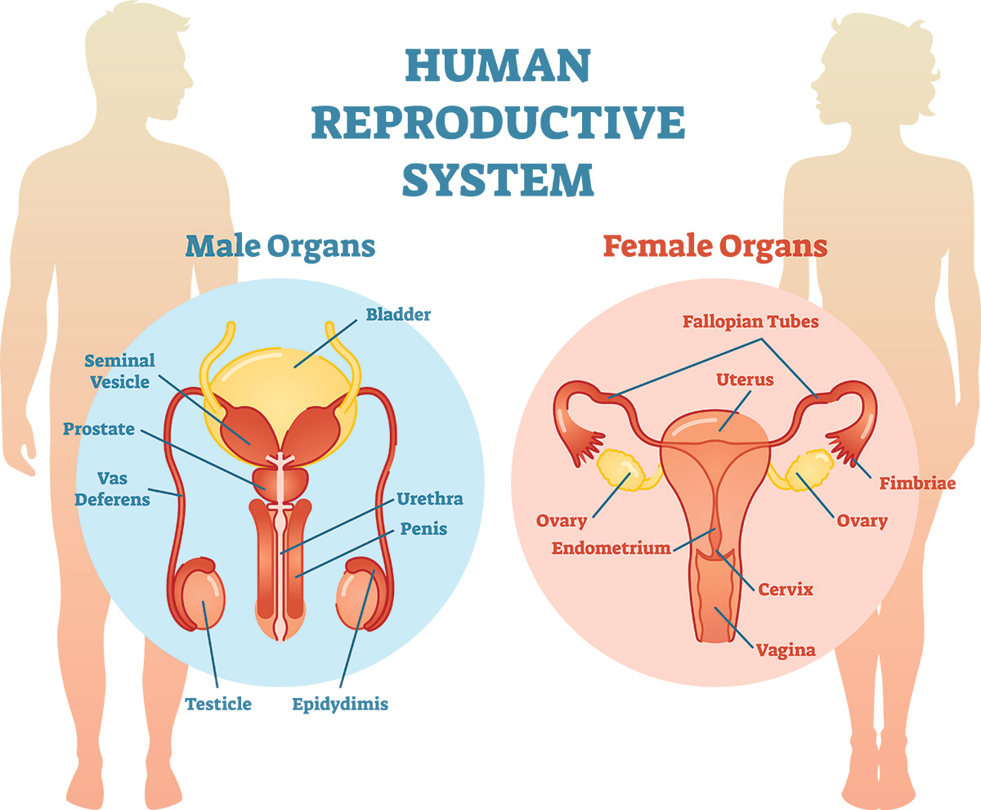
More than making babies
Connects
Development
Metabolism
Cardiovascular
Skeletal, muscular
In females
Regulation of being pregnant
Placenta

Slide 49
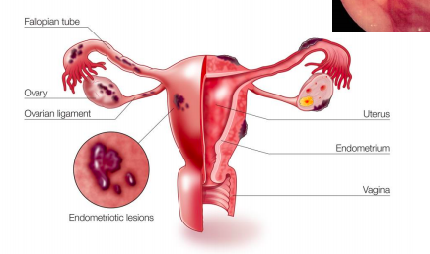
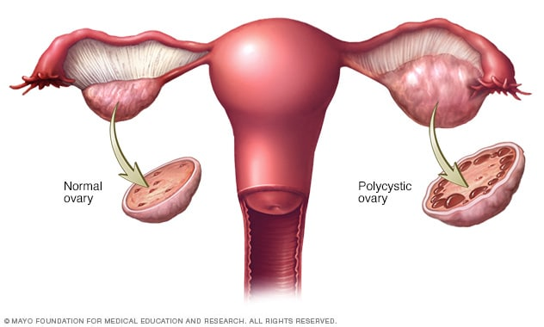
Female reproductive syndromes
Polycystic ovarian syndrome
8% of reproductive age females
High risk for cardiovascular disease (CVD), diabetes, and metabolic syndrome
Infertility
Endometriosis
10% of reproductive age females
Symptomatic,
Pelvic pain, and intense dysmenorrhea–painful menstruation
Asymptomatic,
Damage and dysfunction of surrounding organs

Slide 50


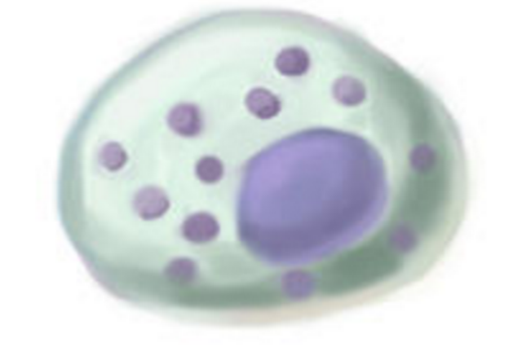
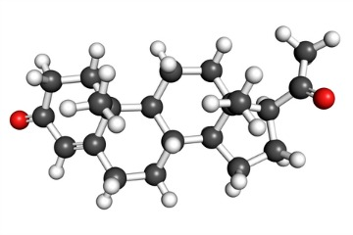
Pregnancy
Immune response
Angiogenesis
Endocrine function
Transfer, nutrients/wastes
Must concurrently function and develop
O₂
CO₂
Notes:
What the placenta does and this is during a developmental context earilest implatation to term must function at every stage,

Slide 51
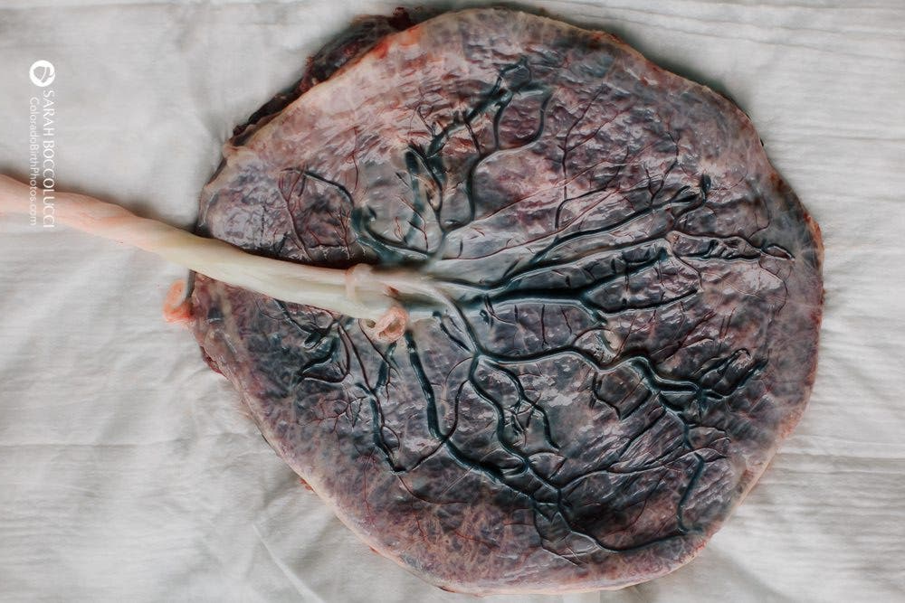
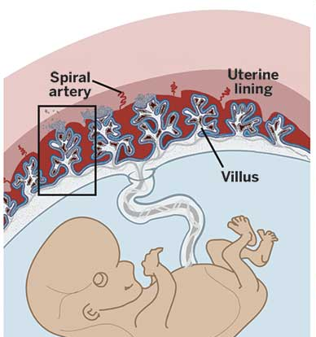
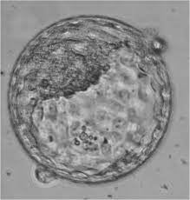
Organ development
Trophoblast forms the placenta
The first lineage to develop
Forms from an interaction of fetal and maternal tissue
7 days
12 weeks
Term (40 weeks)

Slide 52
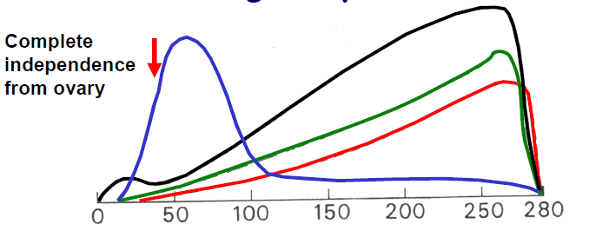
Endocrine organ
Human chorionic gonadotropin
Progesterone
Estrogen
Human placental lactogen (also called human chorionic somatomammotropin)
days of pregnancy
Notes:
Placental hormone secretion is developmentally regulated
Beta-HCG (human chorionic gonadotropin)
Maintains the corpus colosum and maintain estradiol productions
Placenta generates estrogen and progesterone, bHCG is reduced, copus colosum stops
What other endocrine effects does it have?

Slide 53
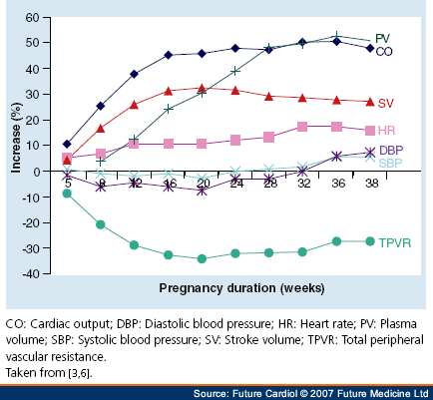
The placenta regulates cardiovascular function
Increased demand of placenta
Large plasma volume
Increased heart rate
Decreased blood pressure
Reduce peripheral vascular resistance
Increased capillarization
Increased lung alveoli
Notes:
Cannot be placenta-centric in view need to consider the mothers adaptive responses

Slide 54
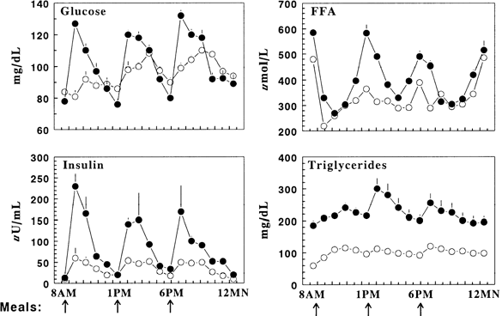
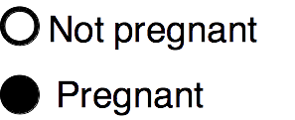
The placenta regulates metabolism
Increased placental/fetal demand
Maintain higher energy load in the blood
Insulin resistance
Notes:
Cannot be placenta-centric in view need to consider the mothers adaptive responses

Slide 55
What can go wrong?
Preterm birth
Labor and iatrogenic (caused by the cure)
Prevalent, 8% in Canada over half are unknown cause (idiopathic)
No real treatments, anecdotal
Premature births cost about $25 billion in the USA
Preeclampsia
Systemic disease, hypertension, lethal
Begins around the 25th week of pregnancy
Leading cause of fetal and maternal death in the developing world, >70,000 maternal and 500,000 neonatal deaths per year
One third of all hospital admissions during pregnancy
Affects 5-8% of all pregnancies globally

Slide 56
Long term effects on the child
Low birth weight correlates to multiple chronic health problems

Slide 57
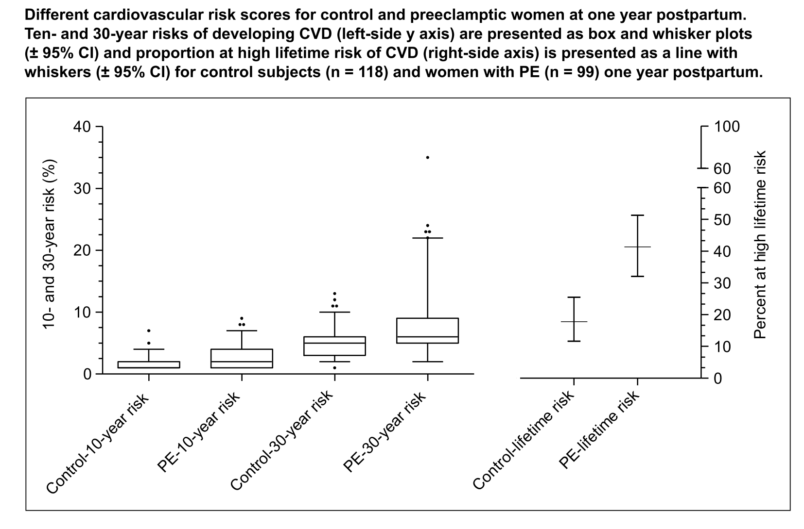
Long term maternal health suffers
1. Smith GN, Jessica P, Walker M, Wen S, Emerging PN. Cardiovascular Disease Risk Estimates Preeclampsia. 2012

Slide 58
Reproductive organs are generally poorly researched
Keyword | Total Matching Articles
Brain | 1 024 560
Heart | 857 851
Liver | 837 791
Lung | 628 410
Kidney | 444 876
Breast | 443 590
Prostate | 190 916
Ovary | 86 000
Uterus | 68 024
Placenta | 58 776
Testes | 33 069
Penis | 15 738
Many reproductive organs are poorly reached
Some are exceptions, Breast and Prostate
Why?
Mercuri and Cox, in Revision

Slide 59
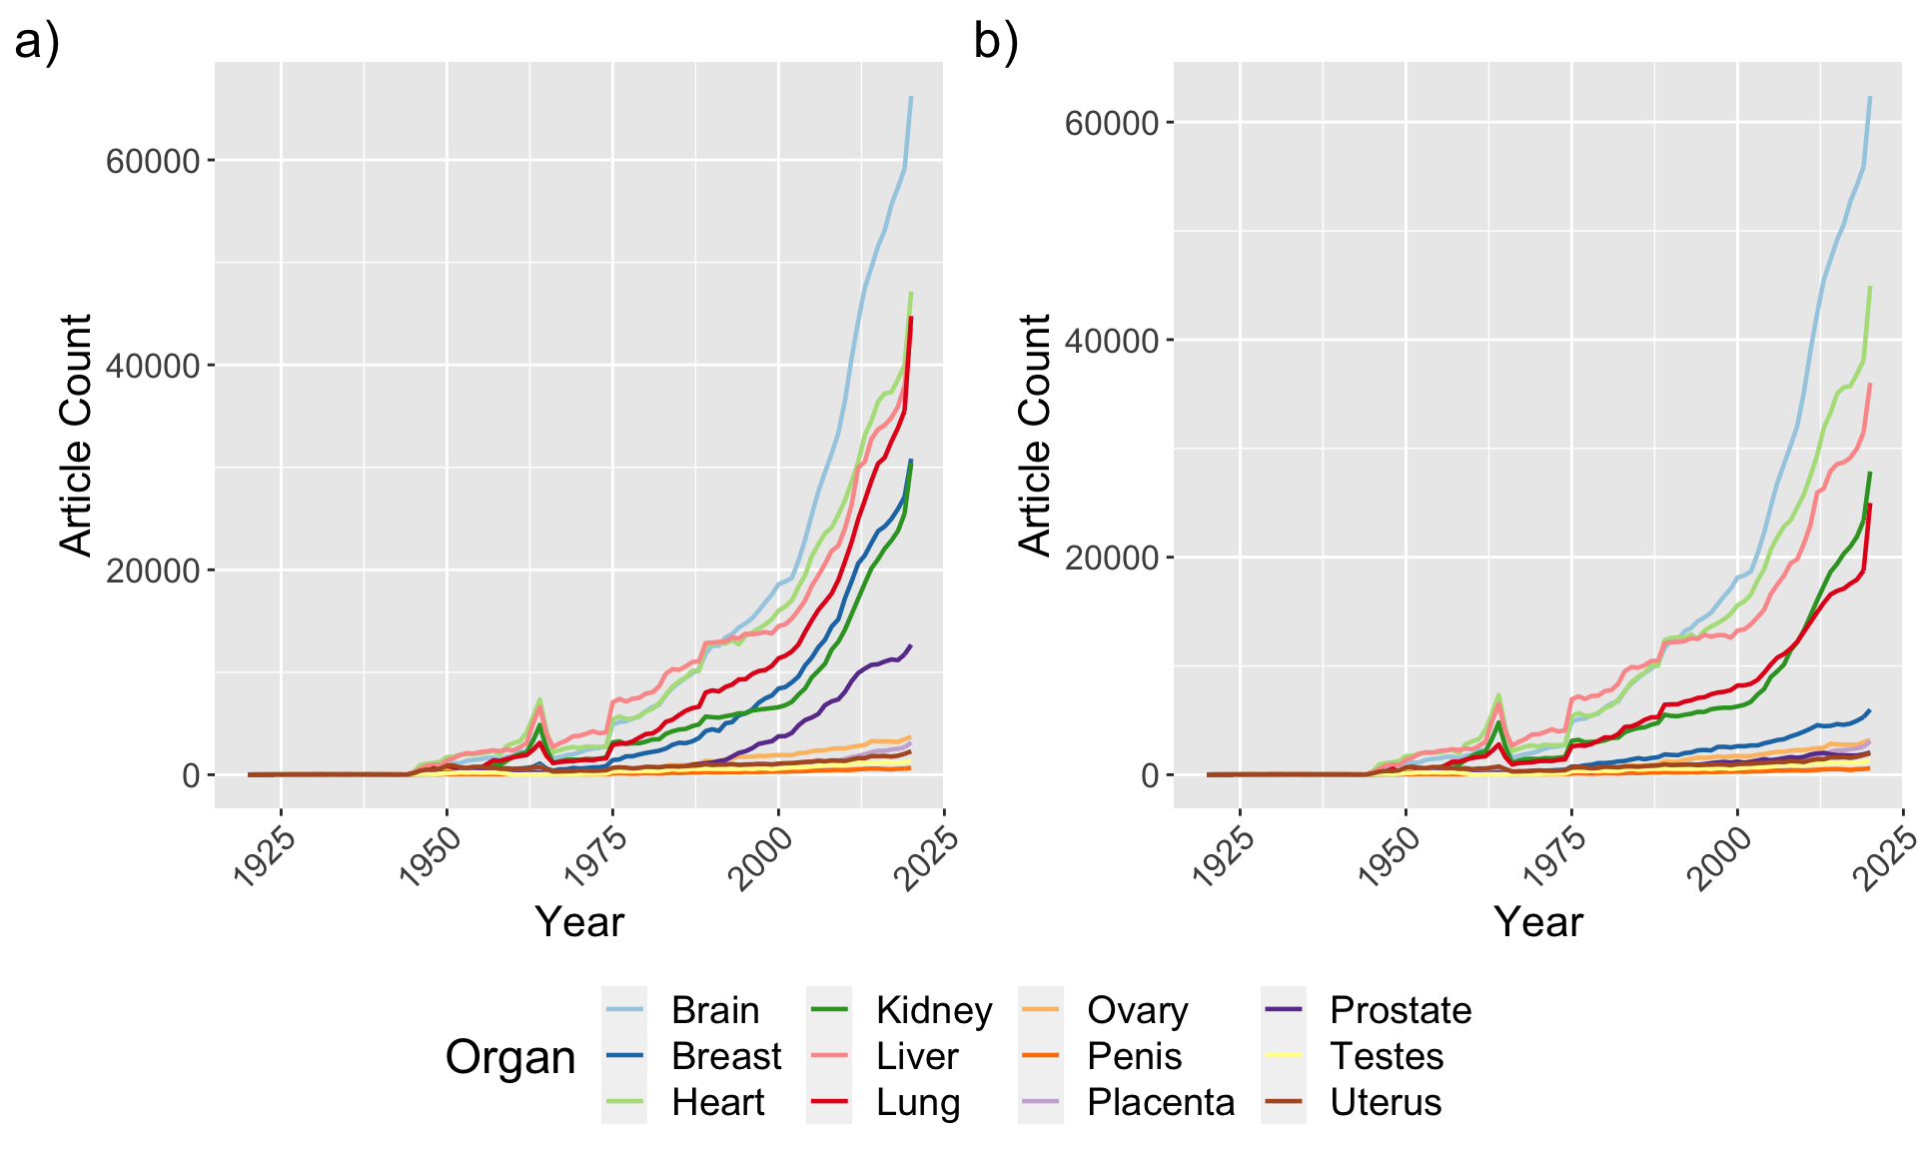
Worse over time
Reproductive organs other and breast and prostate become remain flat
Up to 80% of breast and prostate research involves cancer
Lack of basic biology and reproductive disease focused research

Slide 60
Summary
Pregnancy invokes many adaptive changes
Metabolic
Cardiovascular
Immunological
Largely driven in part of hormonal ques from the placenta, ovary
Unfortunately, least understood area of physiology

Slide 61
Our experiment
Mice aged 8-12 weeks
Two groups
Not pregnant
Pregnant E14.5 (14 day post fertilization)
Collected replicates of
Heart left ventricle
Liver
Lung
What are the adaptive changes in these organs?
Differential expression
Ontology enrichments

